Slide 1

Borislav Statev - Senior Flutter Developer at Via
Smooth transitions between screens in Flutter

Slide 2
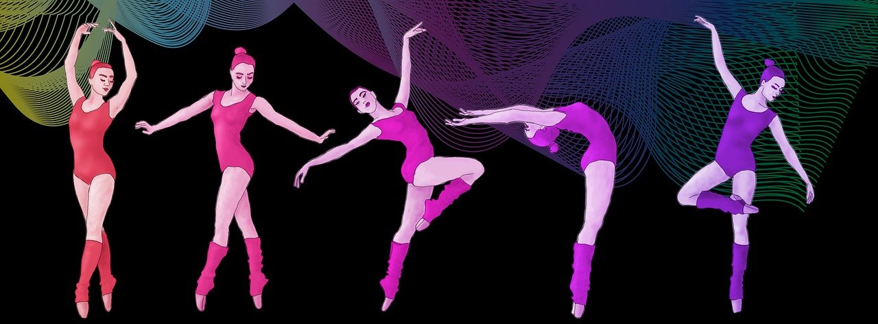
Move between screens like a dancer
- 2 steps forward, 1 step back
- Don’t forget back transition
- Timely, without delay
- Consistent

Slide 3
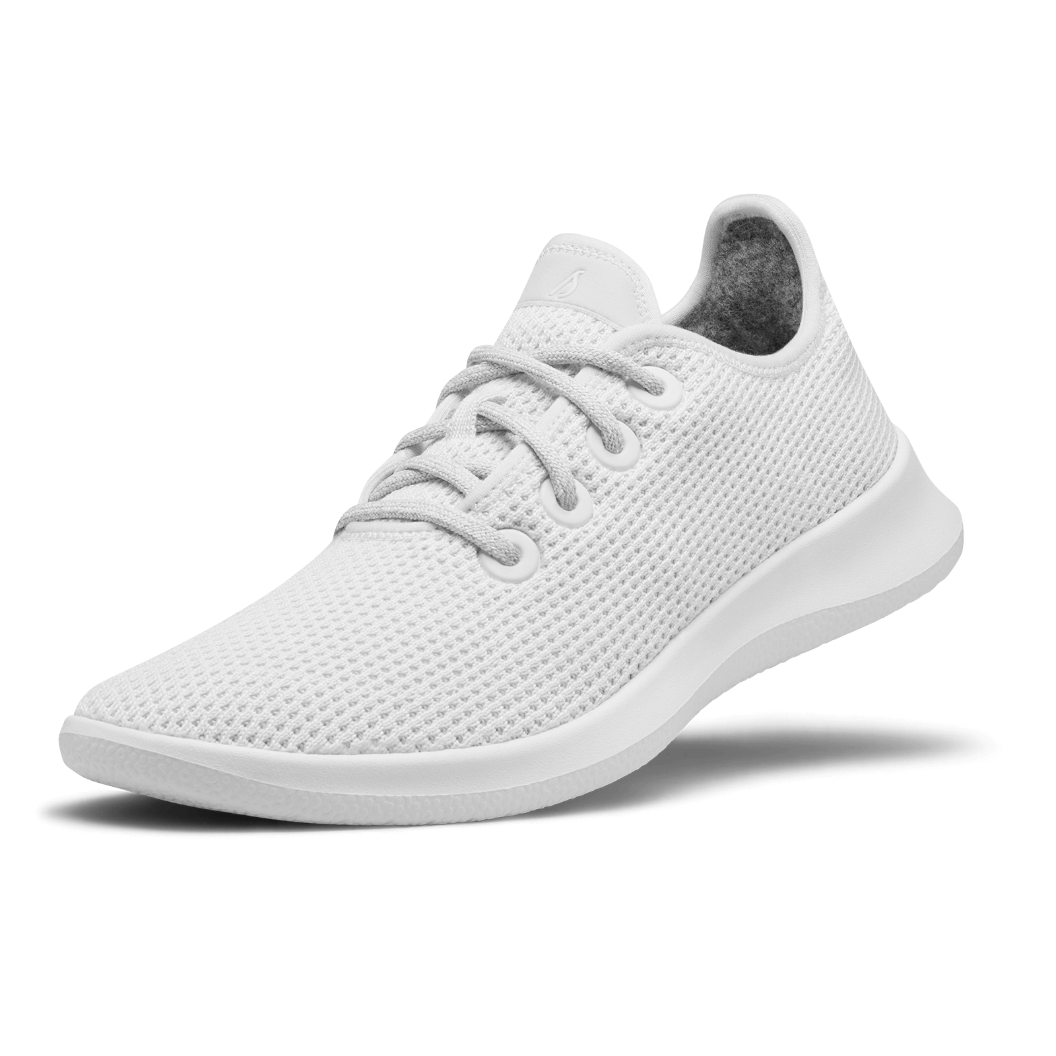

Put on your Flutter shoes
Get a Navigator
- Use a PageRoute

Slide 4

Start with the basic
Using MaterialPageRoute
Android vs iOS

Slide 5

Create your dance
PageRouteBuilder vs expand PageRoute
Change Duration
Forward and Backward
- Customise the transition

Slide 6
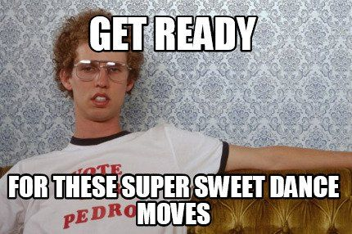
Transition moves
Animations
Slide, Fade, Scale, Size, Rotation
Animation Curve

Slide 7
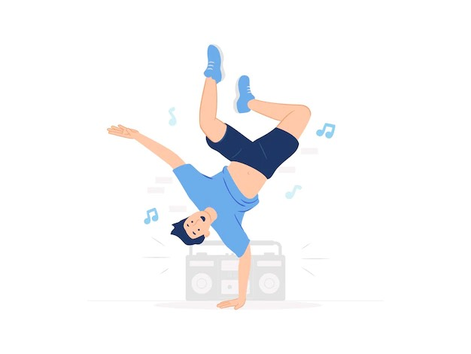
Freestyle
Expand PageRoute
- Create your own animation

Slide 8
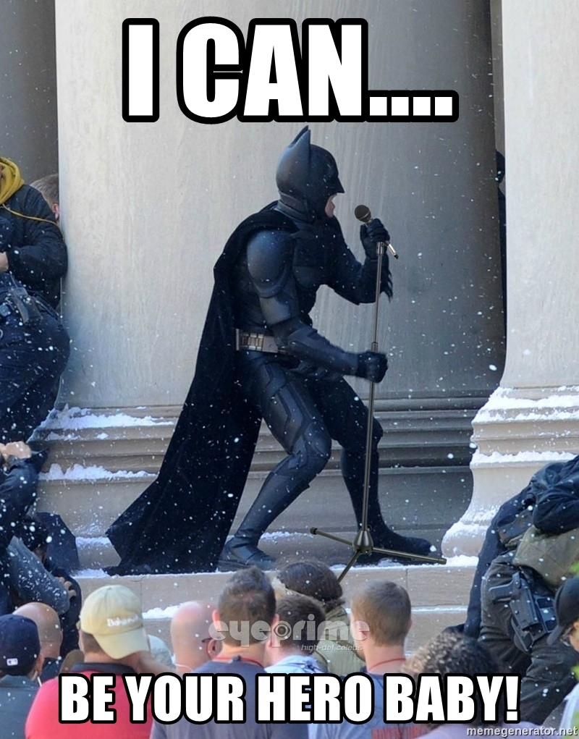
Be a hero at the floor
What is Hero animation?
- How to use it?

Slide 9
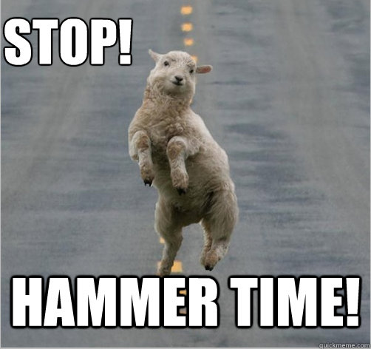
You CAN touch this
Handle user gesture
Communicate between the gesture and the transition

Slide 10
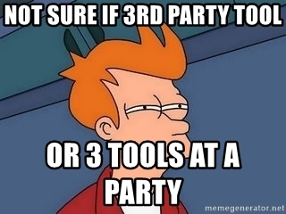
Advanced choreography
Additional 3th party libraries
page_transition
animations
concentric_transition

Slide 11





Contacts:
Linkedin profile
Facebook profile
Github profile
Instagram profile

